Slide 1
Probability & Statistics
Lecturer: Dr. Nguyen Ngoc Ai Van

Slide 2
Part 1 Probability
Lecturer: Dr. Nguyen Ngoc Ai Van

Slide 3
Why study Probability ?
Scientists/Businesses want to be able to quantify the uncertainty of future events.
Ex: What are the chances that revenue next month will exceed last
year’s average?
How likely is it that our new production system will help us decrease our product defect rate?
They also want to understand how they can increase the chance
of positive future events and decrease the chance of negative future events.
Probability allows us to understand and quantify the uncertainty about the future. We use the rules of probability to bridge the gap between what we know now and what is unknown about the future.
Notes:
Positive event: increasing market share
Negative event: failing to meet forecasted sales

Slide 4

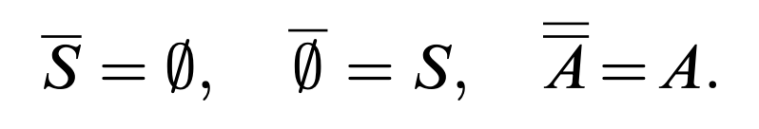

1. Set operation
Let A be a subset of set S.
The complement of A in S is denoted by $\overline{A}$

Slide 5
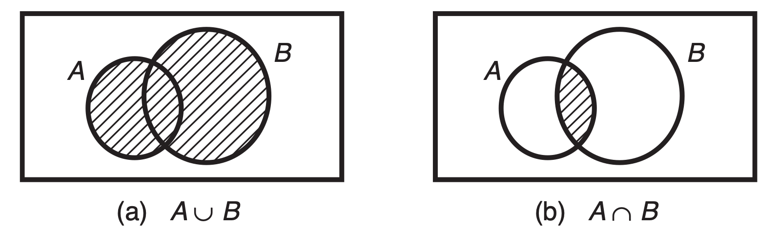
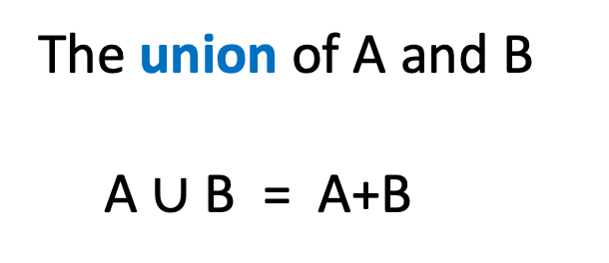
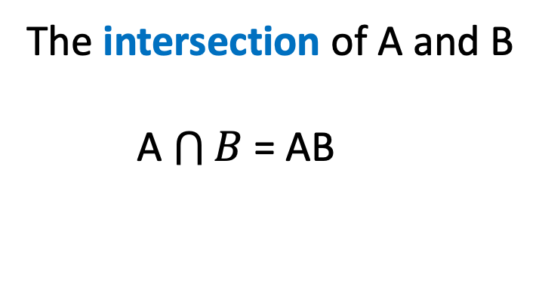
1. Set operation
The union of A and B
A $∪$ B = A+B
The intersection of A and B
A $\bigcap{B}$ = AB

Slide 6
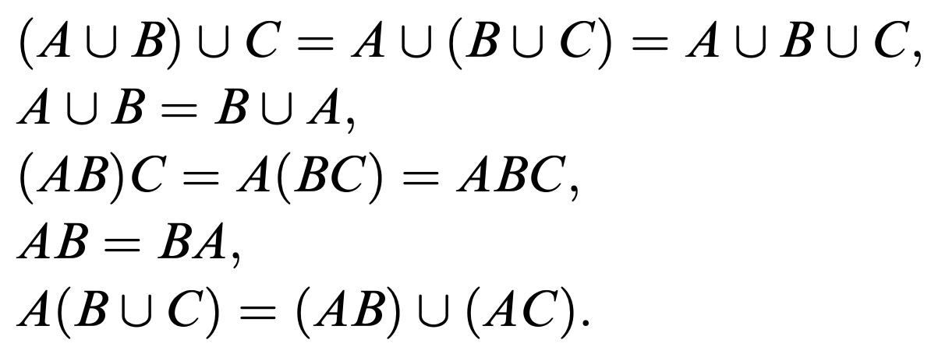
1. Set operation

Slide 7
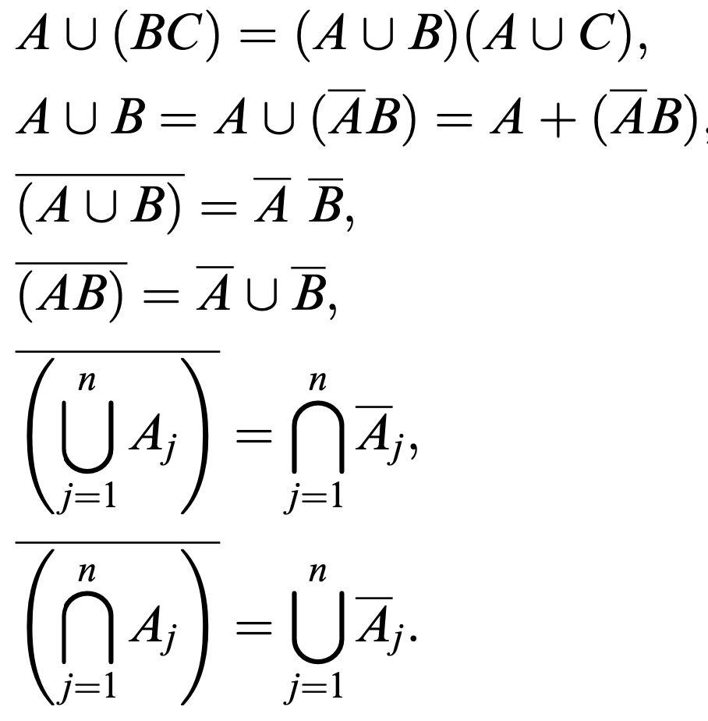
1. Set operation

Slide 8
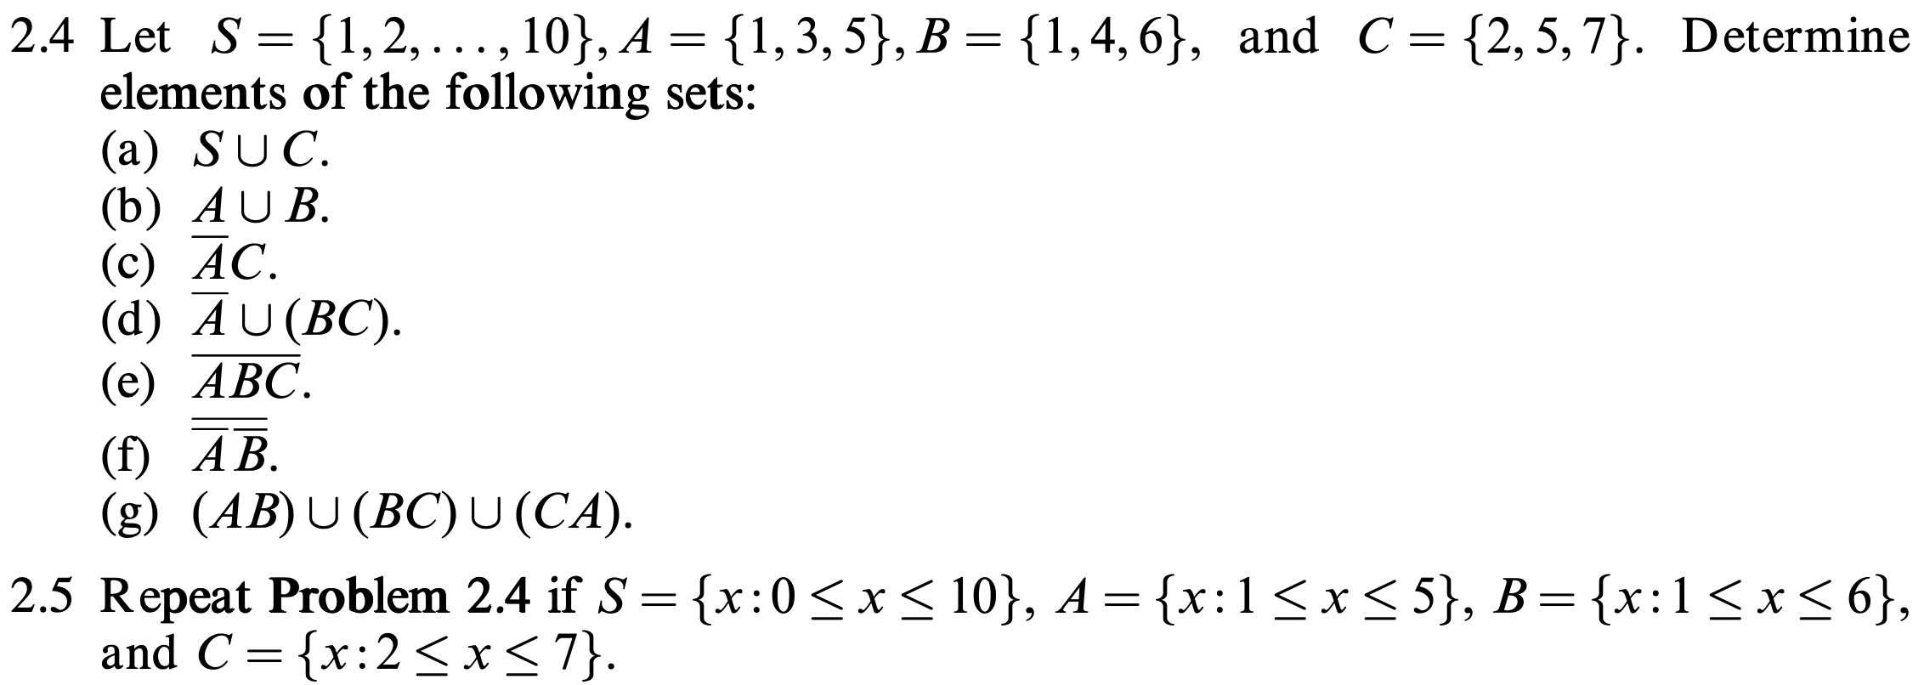
Exercises

Slide 9

2. Probability Concepts
A random experiment is a process whose results cannot be known in advance.
Ex:
Tossing a coin
Observing a customer enter a store, we don’t know if the customer will buy something or not, and how much the customer will spend.
The sample space for an experiment is the set of all possible outcomes, denoted S.
Ex:
The sample space describing a customer’s payment method might have four outcomes:
S = {cash, debit card, credit card, check}
The sample space to describe rolling a die has six outcomes:
S ==

Slide 10
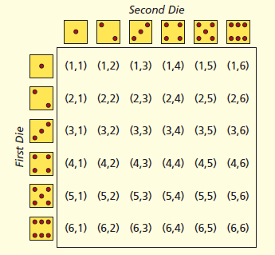
Ex: When two dice are rolled, the sample space consists of 36 outcomes, each of which is a pair:

Slide 11
A sample space could be so large that it is impractical to enumerate the possibilities
Ex:
The sample space for the 12-digit bar code on a product could have 1 trillion values.
The sample space for the length of a randomly chosen cell phone call would be
S = {all X such that X ≥ 0}
The sample space to describe a randomly chosen student’s GPA would be
S = {all X such that 0 ≤ X ≤ 10}

Slide 12
Event
An event is any subset of outcomes in the sample space. A simple event, or elementary event, is a single outcome.
Ex :
The sample space for the experiment of tossing a fair coin one time is
S = {head, tail}. These two elementary events are equally likely.
The sample space to describe buying a lottery ticket is S = {win, lose}. These elementary events are not equally likely.
Ex: Tossing a fair coin 2 times.
S= {HH, HT, TH, TT}
{at least 1 head} = {HH, HT, TH}
{exactly one head} = {HT, TH} = {exactly one tail}

Slide 13
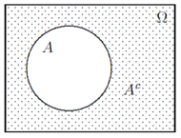
The complement of an event A is denoted A^{c} and consists of everything in the sample space S except event A.
Example: Tossing a die
S = {1,2,3,4,5,6}
A = {1, 3}
A^{c} = {2,4,5,6}
Example:
S = {a customer’s payment method} = {cash, debit card, credit card, check}
A = {cash}
A^{c} = {debit card, credit card, check}

Slide 14
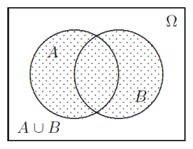
Set operation
A union of events A,B,C, . . . is an event consisting of all the outcomes in all these events.
The union of A and B is sometimes denoted A ∪ B or “A or B”
Ex 1: Tossing a die
S = {1,2,3,4,5,6}
A = {1, 3} , B = {3, 4, 6}
A ∪ B = {1, 3, 4, 6}
Ex 2: V = {a customer has a Visa card}.
M = { a customer has a MasterCard}
V ∪ M = ?

Slide 15
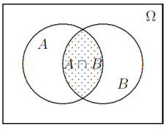
An intersection of events A, and B is an event consisting of outcomes that
are common in all these events.
The intersection of A and B is denoted
A ∩ B or “A and B”
Ex 1: Tossing a die
S = {1,2,3,4,5,6}
A = {1, 3} , B = {3, 4, 6}
A ∩ B = {3}
Ex 2: V = { a customer has a Visa card }.
M = { a customer has a MasterCard}
V ∩ M = ?

Slide 16
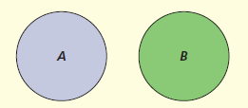
Events A and B are mutually exclusive (or disjoint) if their intersection is the empty set (a set that contains no elements).
Example: Customer age: A = under 21, B = over 65
Note:
A and A^{c} are disjoint.
If A and B are mutually exclusive, it means that if A happens then B does not happen; and if B happens then A does not happen.

Slide 17

Events A and B are mutually exclusive and exhaustive if
A $∩ B= ∅$ and A $∪ B= S$

Slide 18
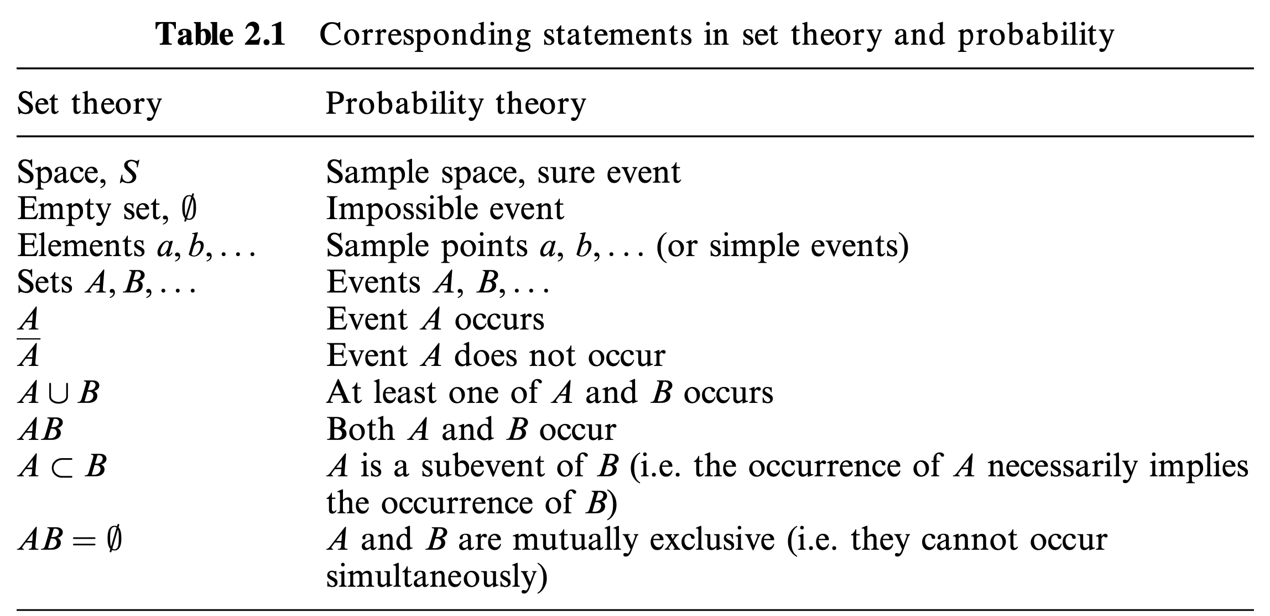

Slide 19
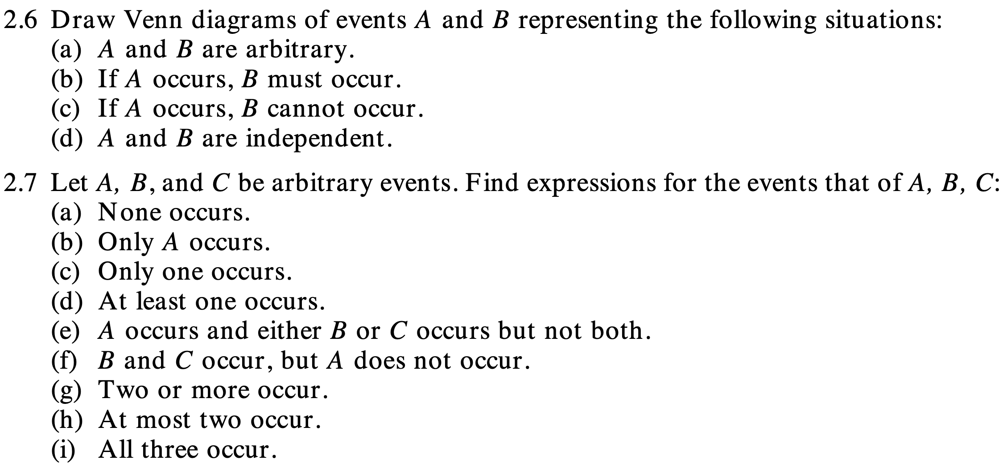
Exercises

Slide 20
Probability in everyday life
In everyday life, probability of an event is understood as a chance that this event will happen.
Example 1: On weather forecast news
“It is going to be partly sunny and there’s a 20% chance of rain tomorrow.”
“There’s a 95% chance of rain tomorrow”.
Exampe 2: If a fair coin is tossed, we say that it has a 50-50 (equal) chance of turning up heads or tails. Hence, the probability of each side equals 1/2. It does not mean that a coin tossed 10 times will always produce exactly 5 heads and 5 tails. However, if you toss a coin 1 million times, the proportion of heads is anticipated to be very close to 1/2.

Slide 21
Probability in everyday life
Example 3: In gambling and lottery, probability is equivalent to odds. Odds in favor of an event A is the ratio of the probability that event A will occur to the probability that event A will not occur.
Having the winning odds of 1 to 99 (1:99) means that the probability to win is 0.01, and the probability to lose is 0.99. It also means that if you play
long enough, you will win about 1% of the time.

Slide 22
Example 4:
Of the population aged 16–20, 29 percent are high school dropouts. It means there is a 29 percent chance of that a randomly chosen member of this population is a high school dropout.
We say that the probability that a randomly chosen member of this population is a high school dropout is 0.29.

Slide 23
Definitions of probability
The probability of an event is a number that measures the relative likelihood that the event will occur.
The probability of an event A, denoted P(A), must lie within the interval from 0 to 1:
0 ≤ P(A) ≤ 1.
P(A) = 0 means the event A cannot occur.
P(A) = 1 means the event A is certain to occur.
If A and B are disjoint events, then P(A ∪ B ) = P(A) + P(B)
P(Ω) = 1

Slide 24
Probability in discrete sample spaces
In discrete sample space
Ω = {E₁, E₂, …, E_{n}}, where E₁, …, E_{n} are simple events,
the probabilities of all simple events must sum to 1, i.e.,
P(Ω) = P(E₁) + P(E₂) + …+ P(E_{n}) = 1.
Example: The Wall Street Journal reports that about 33 percent of all new small businesses fail within the first 2 years (July 12, 2004).
P(failure) = 0.33
P(survival) + P(failure) = 1
→ The probability that a new small business will survive at least 2 years is:
P(survival) = 1 – P(failure) = 1 –0.33 = 0.67

Slide 25
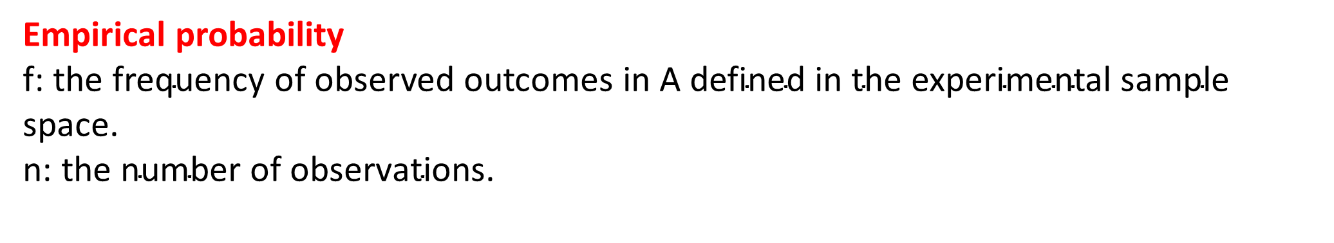
Empirical probability - Relative frequency approach
Example: On average, 2,118 out of 100,000 Americans live to age 100 or older.
A= event that a randomly chosen American lives to 100 or older
Empirical probability
f: $\text{the} \text{frequency} \text{of} \text{observed} \text{outcomes} \text{in} \text{A} \text{defined} \text{in} \text{the} \text{experimental} \text{sample} \text{space}\text{.}$
n: $\text{the} \text{number} \text{of} \text{observations}\text{.}$
Note: As we increase the number of observations (n) or the number of times we perform the experiment, our estimate will become more and more accurate.

Slide 26
Classical Approach
Example:
In the two dice experiment, there are 36 possible outcomes, so the probability of rolling a seven is

Slide 27
When the sample space consists of equally likely outcomes, the probability of an event A is

Slide 28
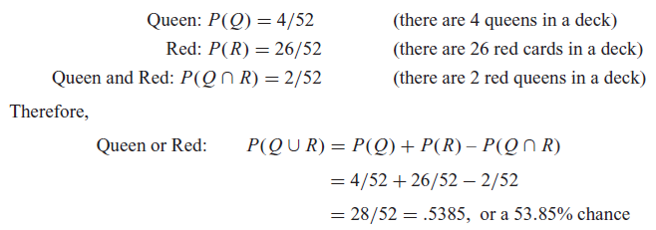
Rules of probability
General Law of Addition
P(A ∪ B) = P(A) + P(B) – P(A ∩ B) for any events A and B.
Example:

Slide 29
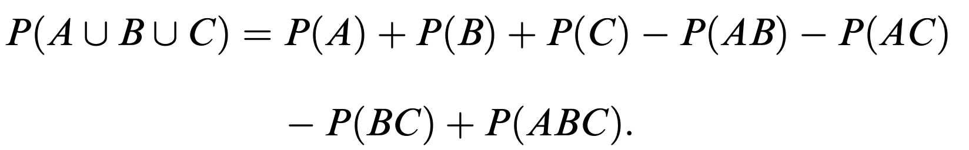
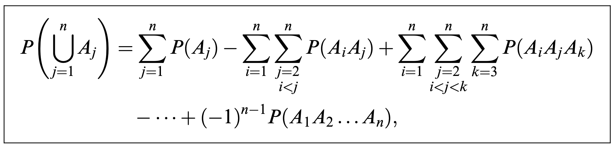

Slide 30
A and B are mutually exclusive events: P(A ∩ B) = 0
→ P(A ∪ B) = P(A) + P(B).
Example: Look at a person’s age
P(under 21) = 0.28
P(over 65) = 0.12
→ P(under 21 or over 65) = 0.28 + 0.12 =0.40.

Slide 31
Example 2.14.
During some construction, a network blackout occurs on Monday with probability 0.7 and on Tuesday with probability 0.5. Then, does it appear on Monday or Tuesday with probability 0.7+0.5 = 1.2? Obviously not, because probability should always be between 0 and 1! Probabilities are not additive here because blackouts on Monday and Tuesday are not mutually exclusive.

Slide 32
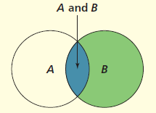

Conditional Probability
The probability of event A given that event B has occurred is a conditional probability, denoted P(A | B).
The conditional probability P(A | B) is the ratio of the relative size of set
A ∩ B to set B.

Slide 33
Conditional Probability
Example 1: Look at a random person’s age
P(under 21) = 0.28
P(under 65) = 0.88
Given that a person’s age is under 65, what is the probability that the person’s age is under 21 ?
Example 2: Of the population aged 16–21 and not in college, 13.50 percent are unemployed, 29.05 percent are high school dropouts, and 5.32 percent are unemployed high school dropouts. What is the conditional probability that a member of this population is unemployed, given that the
person is a high school dropout?

Slide 34
Independent events
Event A is independent of event B or A and B are independent if occurrence of one event does not affect the occurrence of the another.

Slide 35
Example
Given P(A) = .40, P(B) = .50. If A and B are independent, find P(A ∩ B).
Given P(A) = .40, P(B) = .50, and P(A ∩ B) = .05.
(a) Find P(A | B).
(b) In this problem, are A and B independent?
3. Which pairs of events are independent?
a. P(A) = .60, P(B) = .40, P(A ∩ B) = .24.
b. P(A) = .90, P(B) = .20, P(A ∩ B) = .18.
c. P(A) = .50, P(B) = .70, P(A ∩ B) = .25.

Slide 36
Example
4. Based on past data, the probability that a customer at a certain Noodles & Company restaurant will order a dessert (event D) with the meal is .08.
The probability that a customer will order a bottled beverage (event B) is .14.
The probability that a customer will order both a dessert and a bottled beverage is .0112. Is ordering a dessert independent of ordering a bottled beverage?
5. Suppose that a shuttle’s launch depends on three key devices that operate independently of each other and malfunction with probabilities 0.01, 0.02, and 0.02, respectively. If any of the key device malfunctions, the launch will be postponed. Compute the probability for the shuttle to be launched on time, according to its schedule.

Slide 37
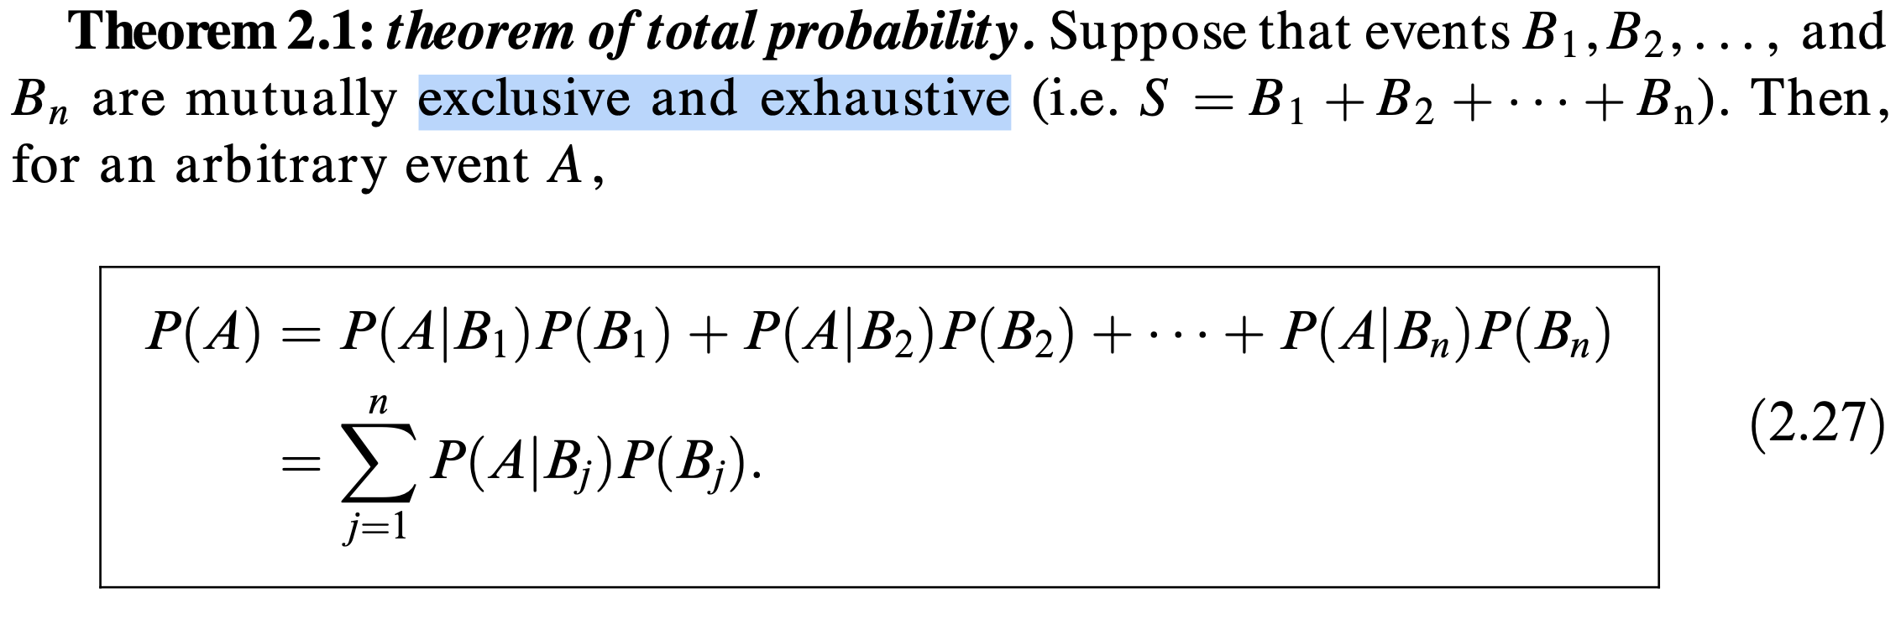

Slide 38
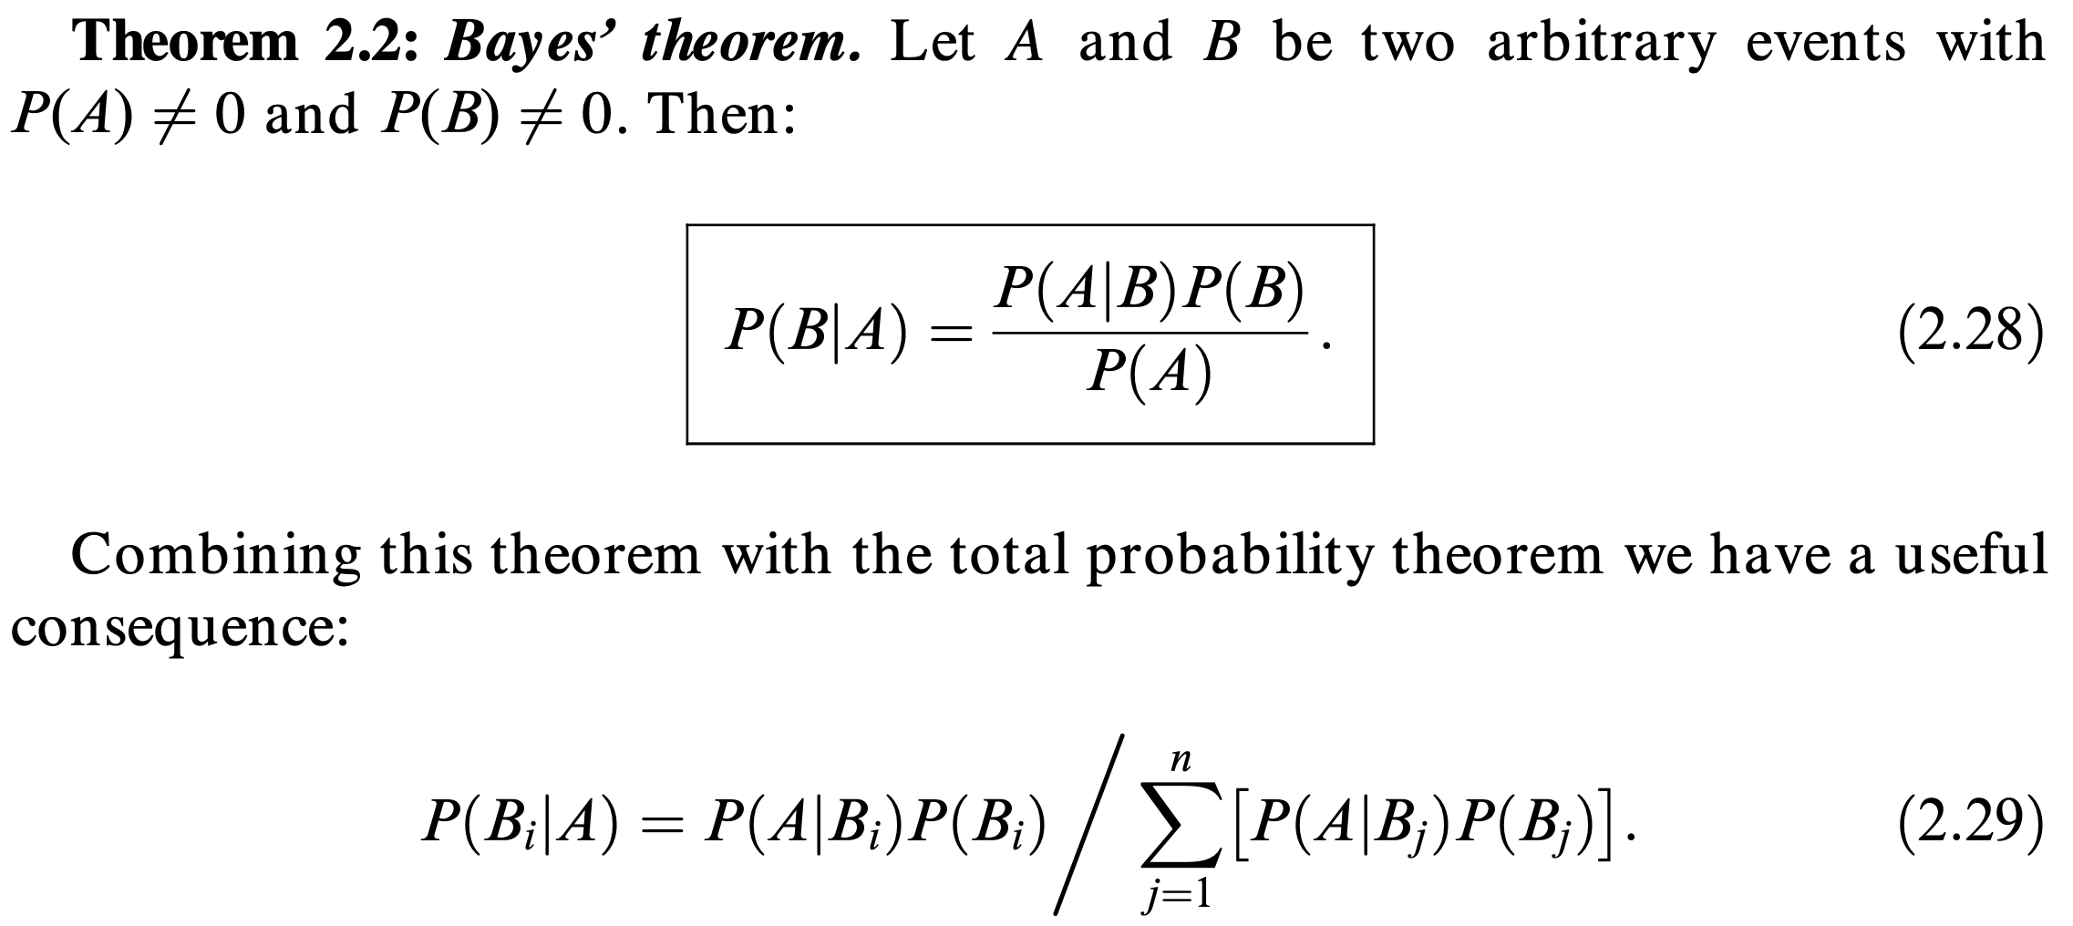
Bayes’ theorem

Slide 39
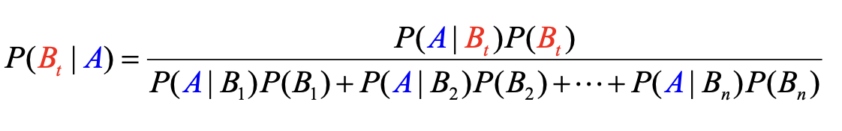
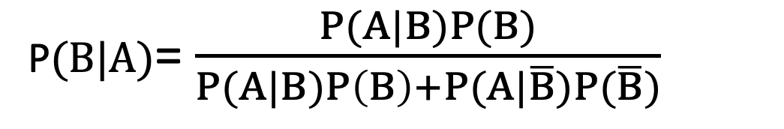
P$(B|A)$= $\frac{P(A|B)P(B)}{P(A|B)P\left(B\right)+P(A|\overline{B})P(\overline{B})}$
${If B}_{1}∪B_{2}∪…∪B_{n}= S and B_{i}∩B_{j}=∅ ∀$ i$≠j$ then

Slide 40
Example
There are 8 red balls and 2 yellow balls in Bag 1.
There are 4 red balls and 6 yellow balls in Bag 2.
Question 1:
Take one ball from Bag 1 and then one ball from Bag 2.
What is the probability of choosing two red balls.
Question 2:
Take one of the bags randomly, then take one ball randomly from this bag.
If the ball taken is red, what is the probability that Bag 1 is chosen ?

Slide 41
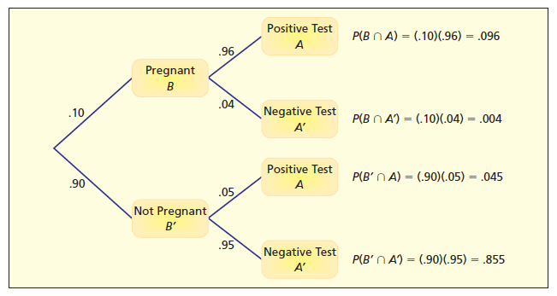
Example
Suppose that 10% of the women who purchase over-the-counter pregnancy testing kits are actually pregnant. For a particular brand of kit, if a woman is pregnant, the test will yield a positive result 96% of the time and a negative result 4% of the time.
If she is not pregnant, the test will
yield a positive result 5% of the time
and a negative result 95% of the time.
Suppose the test comes up positive.
What is the probability that
she is really pregnant ?

Slide 42
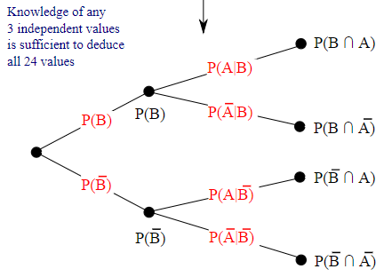
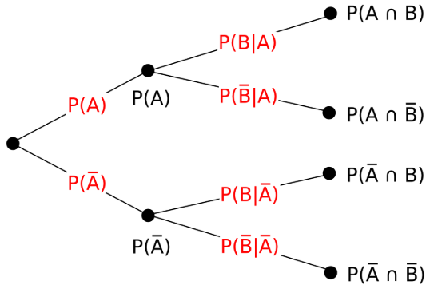
Example

Slide 43
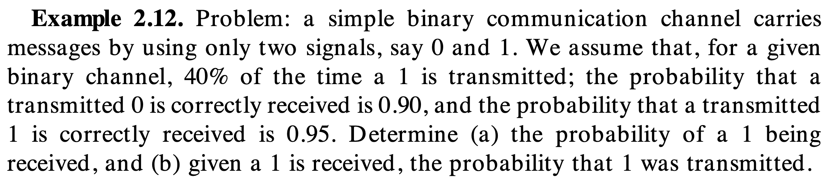

Slide 44
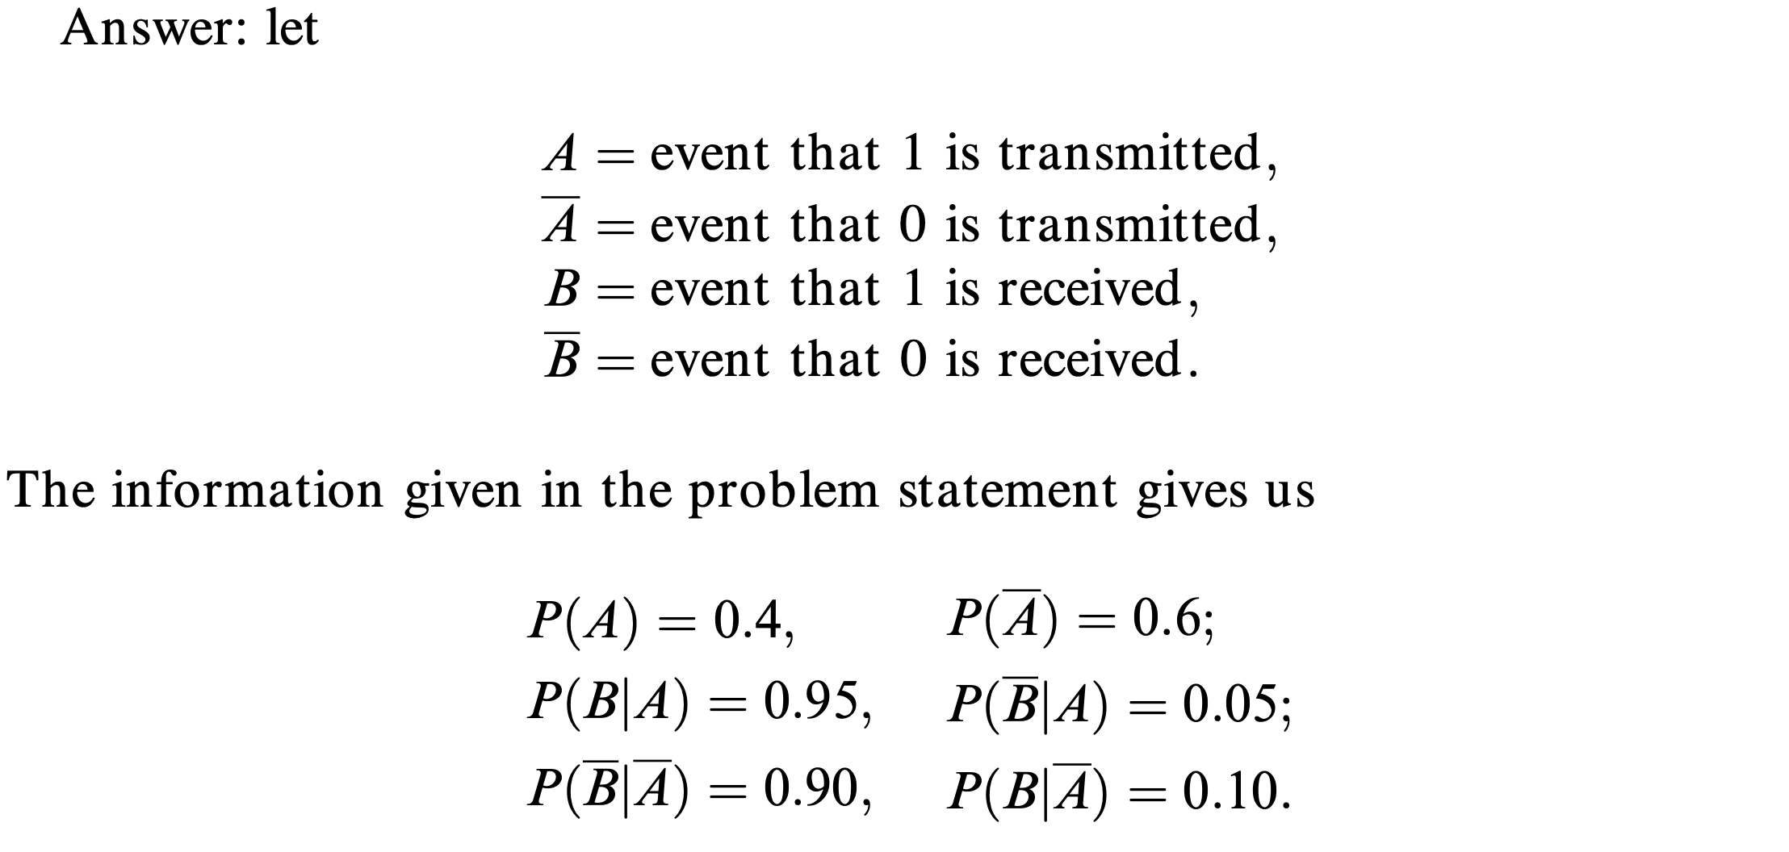

Slide 45
